Slide 1
Introduction to Azure Arc enabled SQL Server
Deepthi Goguri

Slide 2
Overview
What is Azure Arc
How to Connect your SQL Server to Azure Arc
Azure Active Directory Authentication for SQL Server

Slide 3
What is Azure Arc enabled SQL Server
Capability to manage resources outside Azure
Inventory management
Azure Resource Graph Explorer
Best practices assessment
Cost savings through Microsoft Defender for Cloud

Slide 4
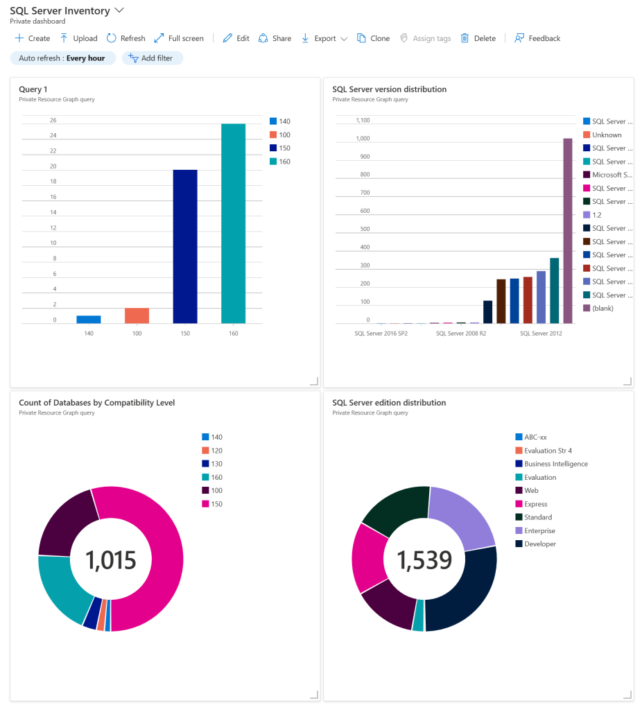
Reference: The diagram as shown on the Microsoft website demonstrates what the SQL Server inventory looks like using the Azure Graph Resource Explorer.

Slide 5
Architecture

Slide 6
Three agents
Azure Connected Machine Agent – This agent will help manage the Windows and Linux machines hosting outside of Azure.
Azure Extension for SQL Server
Azure Monitoring Agent – The Microsoft Defender for cloud and best practices assessment needs this agent. This extension is needed to put the collected data in the log analytics workspace.

Slide 7
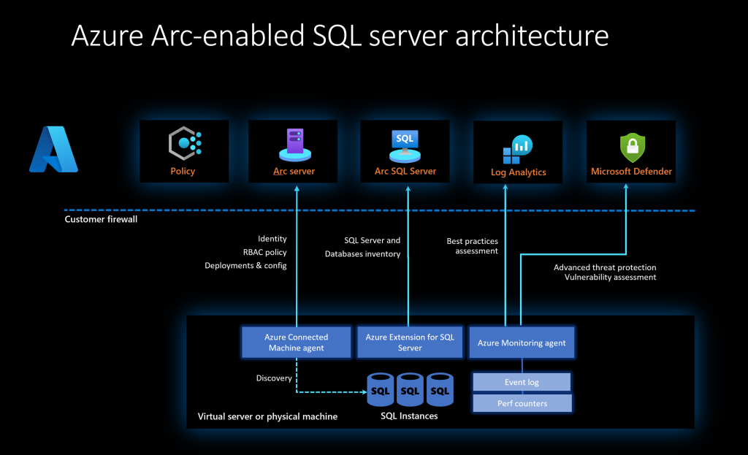
Source

Slide 8
Prerequisites
Active subscription
Verify Arc-connected machine agent network requirements
Azure Arc data processing service – Outbound rules on each server and port 1433
san-af-<region>-prod.azurewebsites.net
Register for the resource providers –
Microsoft.AzureArcData and Microsoft.HybridCompute

Slide 9
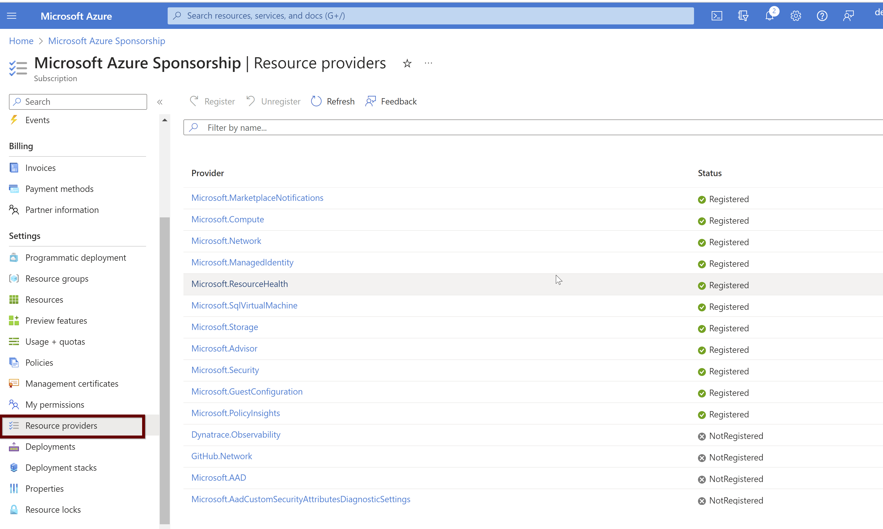

Slide 10
Service Principal Permissions
Read permission to Subscription
Permissions to Azure resource group –
Azure Connected Machine Onboarding role
Microsoft.AzureArcData/register/action
Microsoft.HybridCompute/machines/extensions/read
Microsoft.HybridCompute/machines/extensions/write
Manual Install: Administrator permissions on the machine
At Scale: User Access Administrator role to install the system-managed identity and Resource policy Contributor role assignment at the resource group level or at the subscription level.

Slide 11
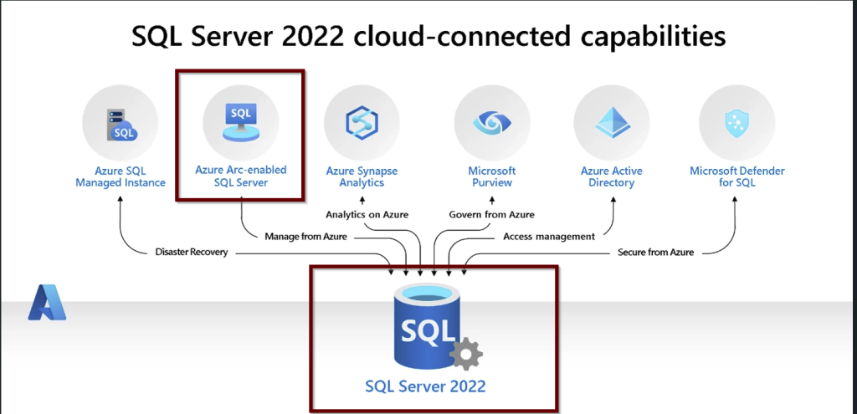
Source

Slide 12
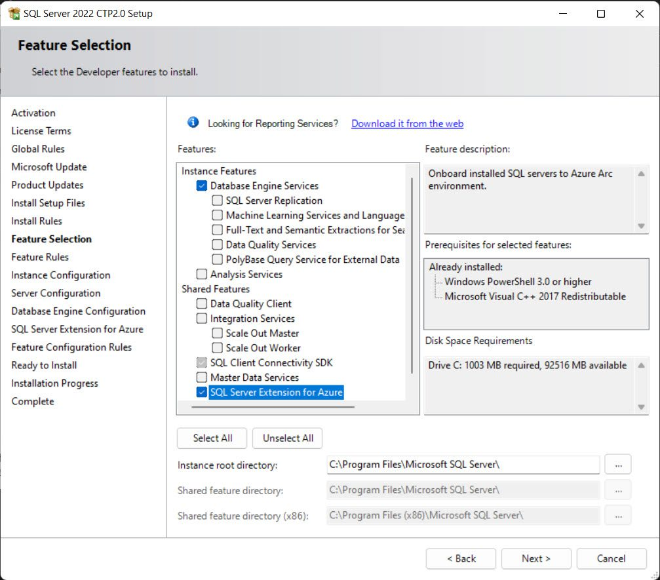
SQL Server 2022

Slide 13
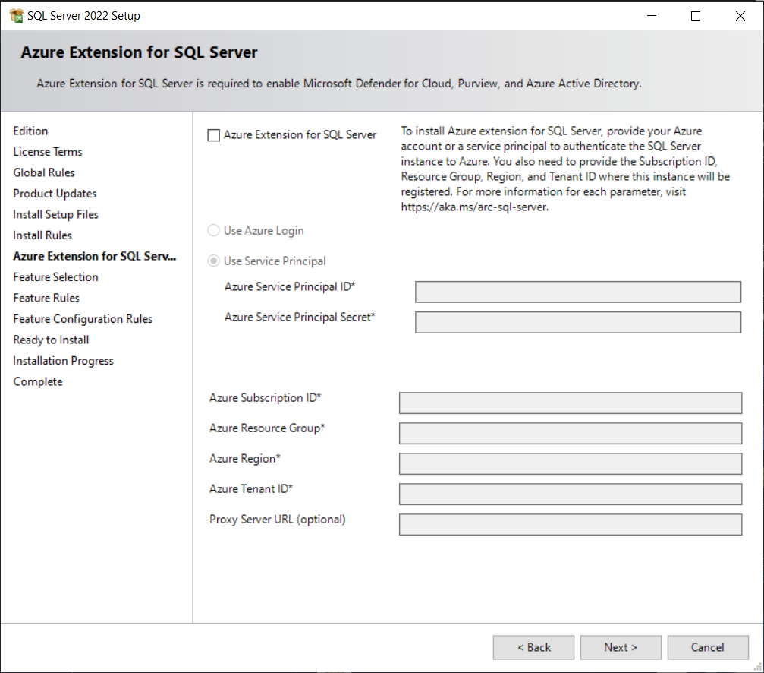

Slide 14


Slide 15
Installation

Slide 16
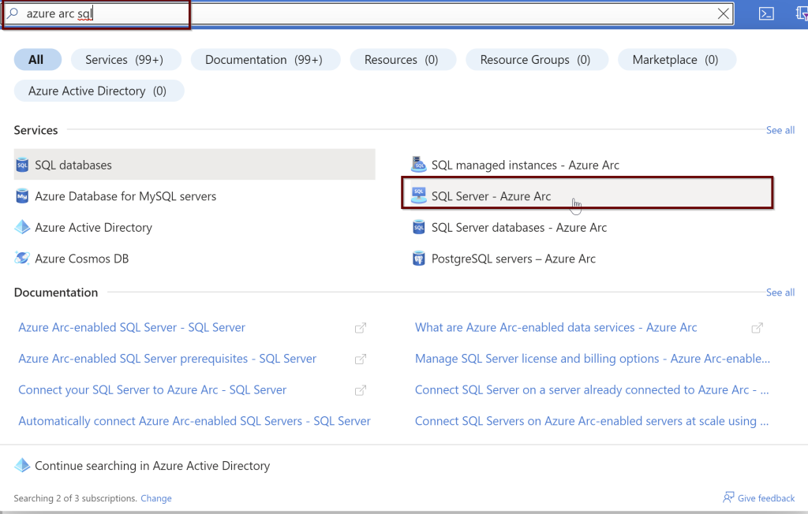

Slide 17
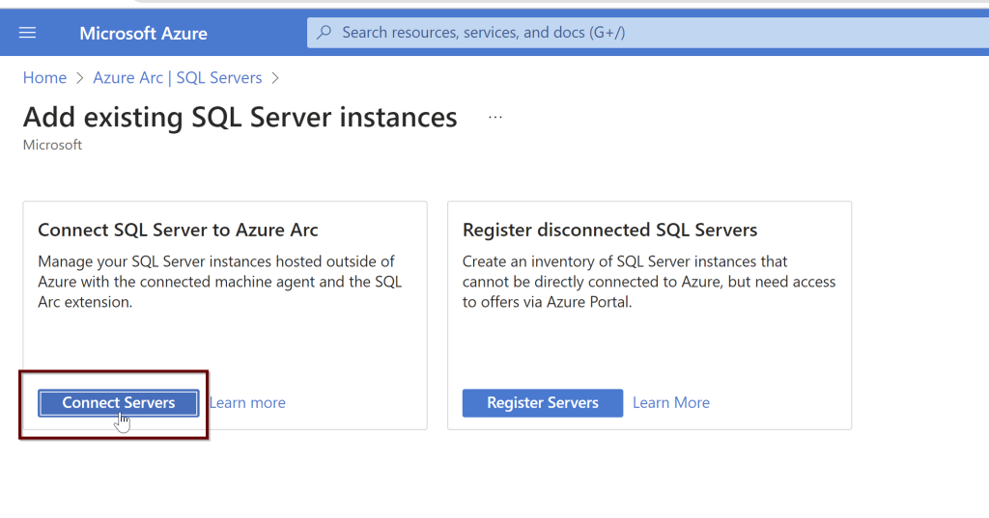

Slide 18
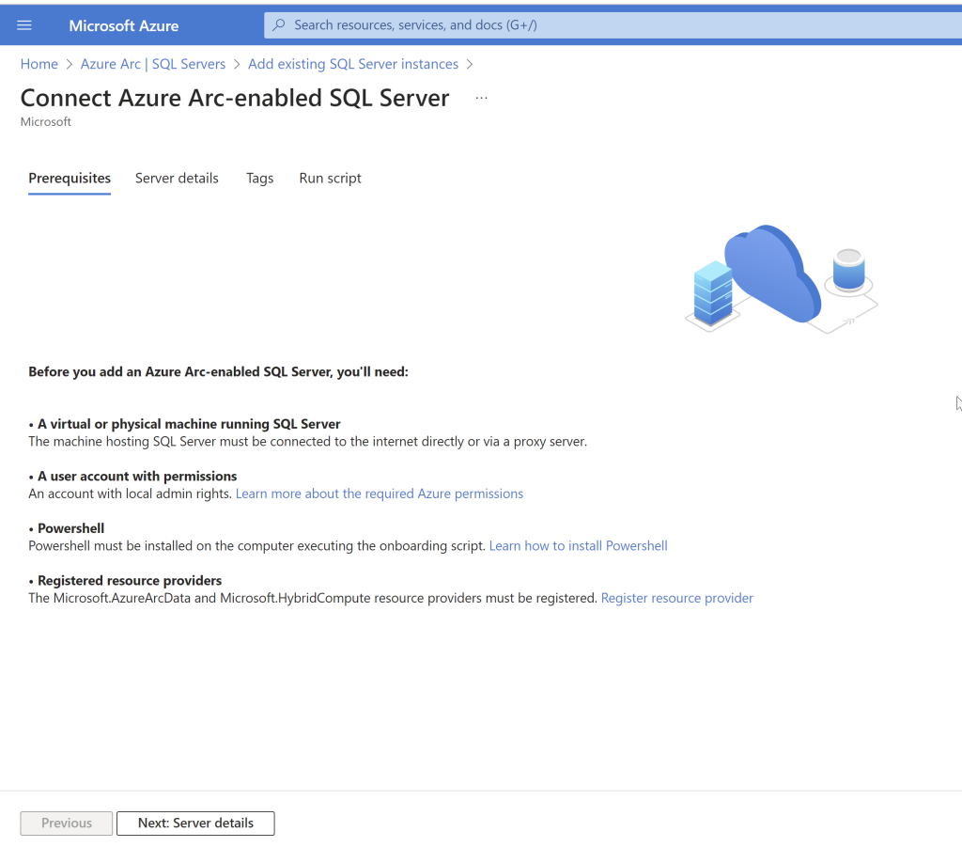

Slide 19
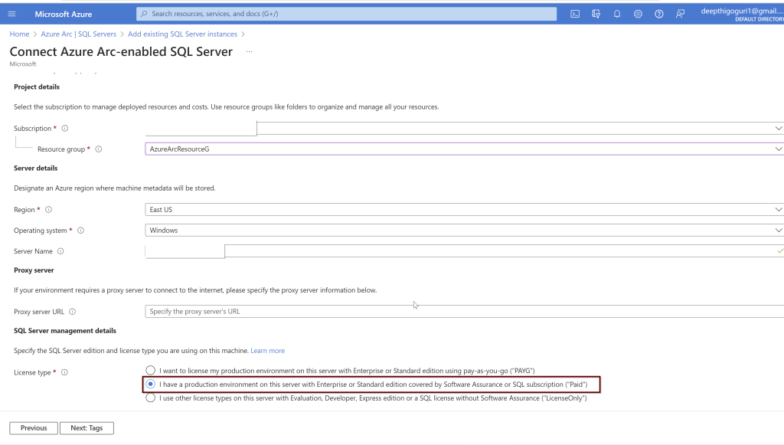

Slide 20

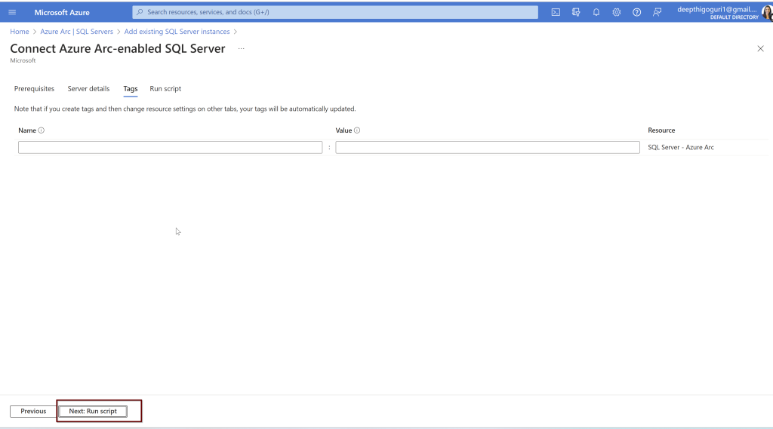

Slide 21
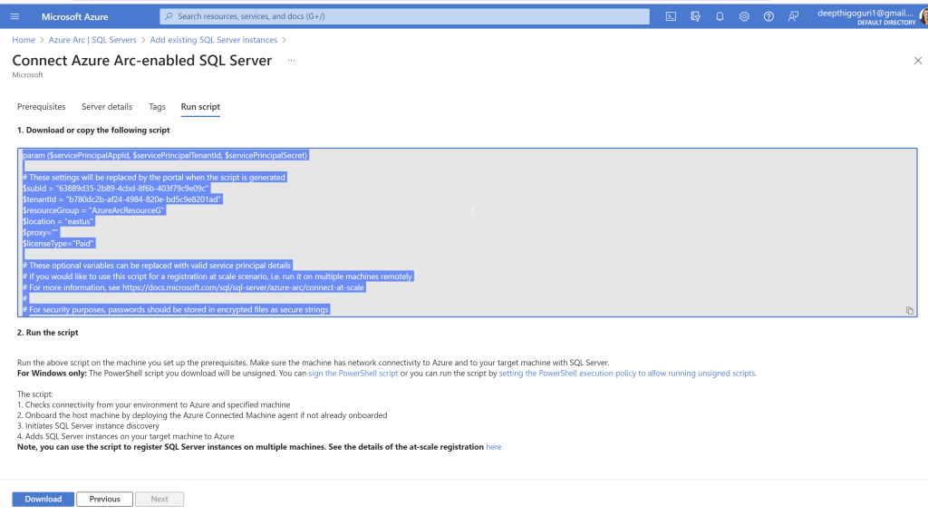

Slide 22
For Windows only: The PowerShell script you download will be unsigned. You can sign the PowerShell script or you can run the script by setting the PowerShell execution policy to allow running unsigned scripts.”
Get-ExecutionPolicy -Scope CurrentUser

Slide 23
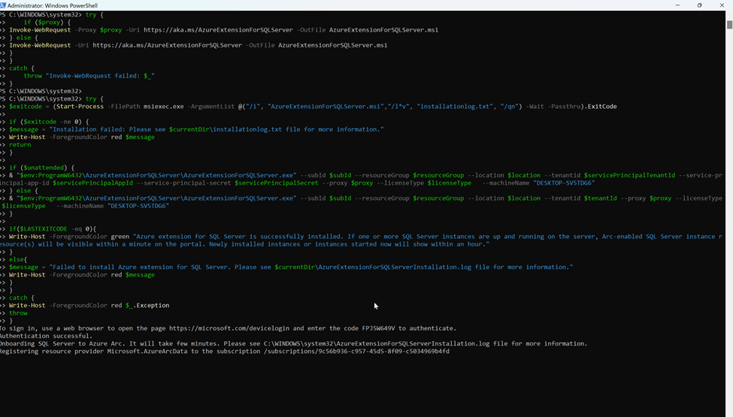

Slide 24
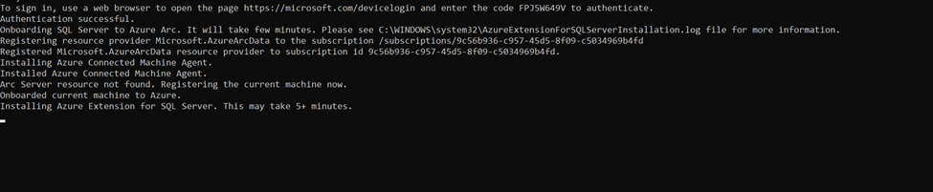

Slide 25
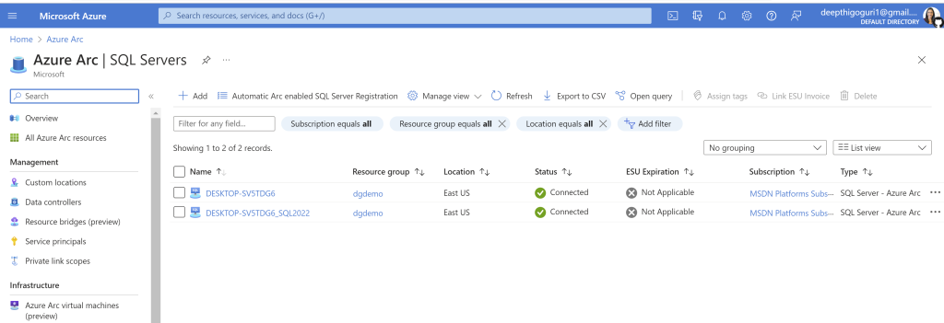
Azure extension for the SQL Server is installed

Slide 26
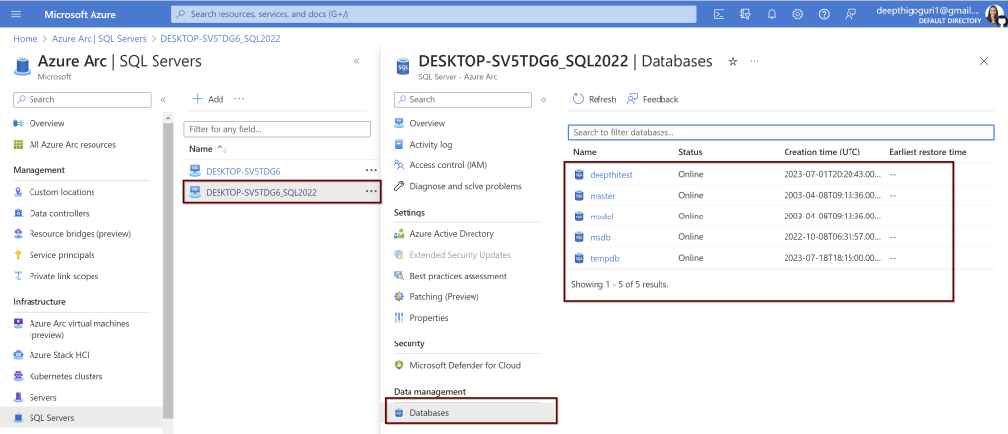

Slide 27
SQL Server 2022: Connect to Azure AD

Slide 28
SQL Server should be connected to Azure cloud through Azure Arc

Slide 29
Prerequisites

Slide 30
Extended functionality –
Certificate → Key Vault → Azure AD application automatically

Slide 31
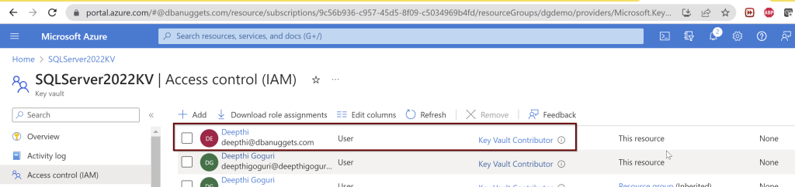
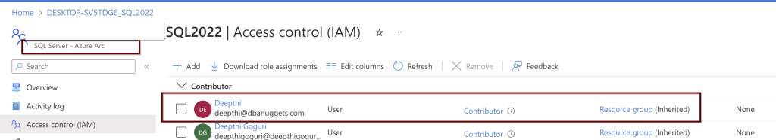
Setup Azure AD admin
Permissions needed: Contributor role for the KeyVault and for the Server as well from the Azure Arc.

Slide 32
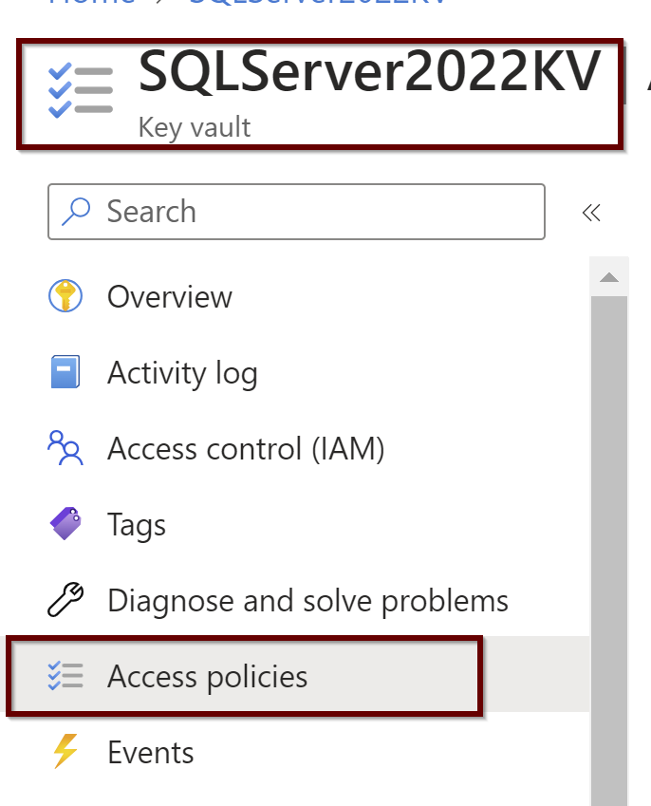
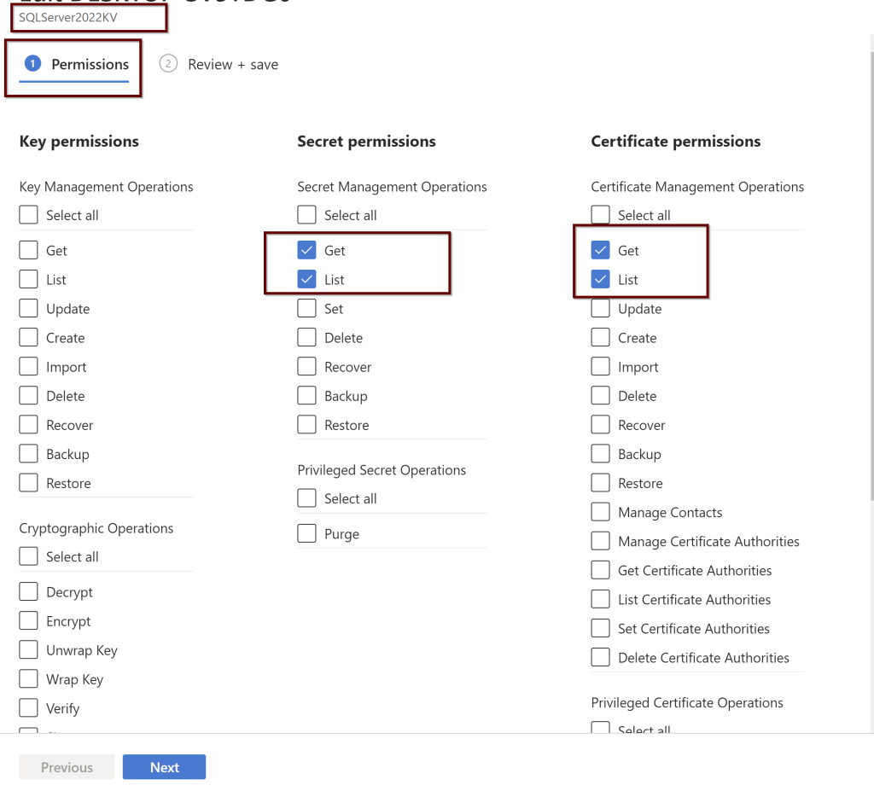
2. Setting up the Access Policies under the KeyVault

Slide 33
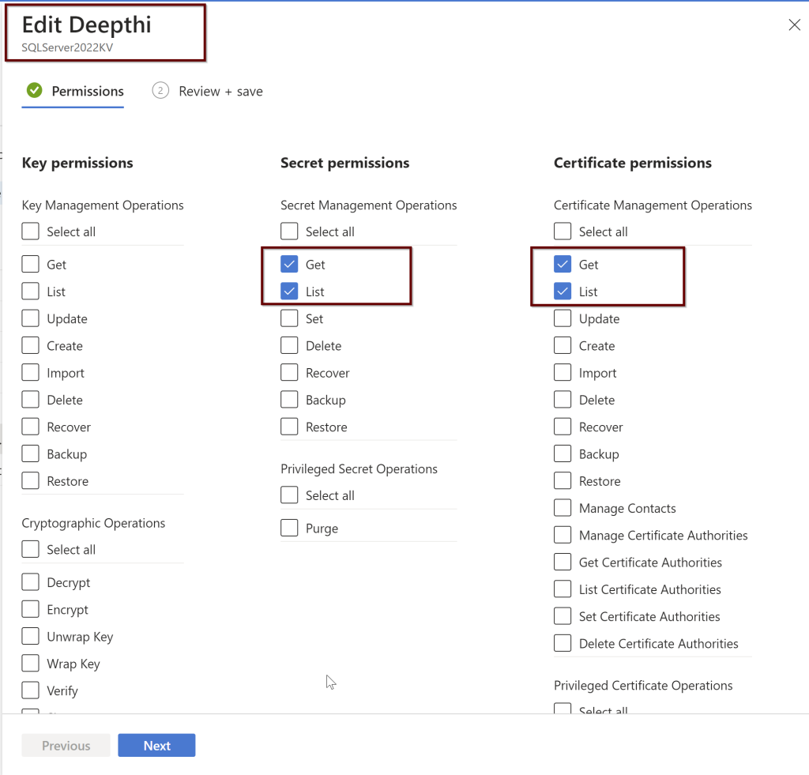
Access policies under Azure AD users 1/2

Slide 34
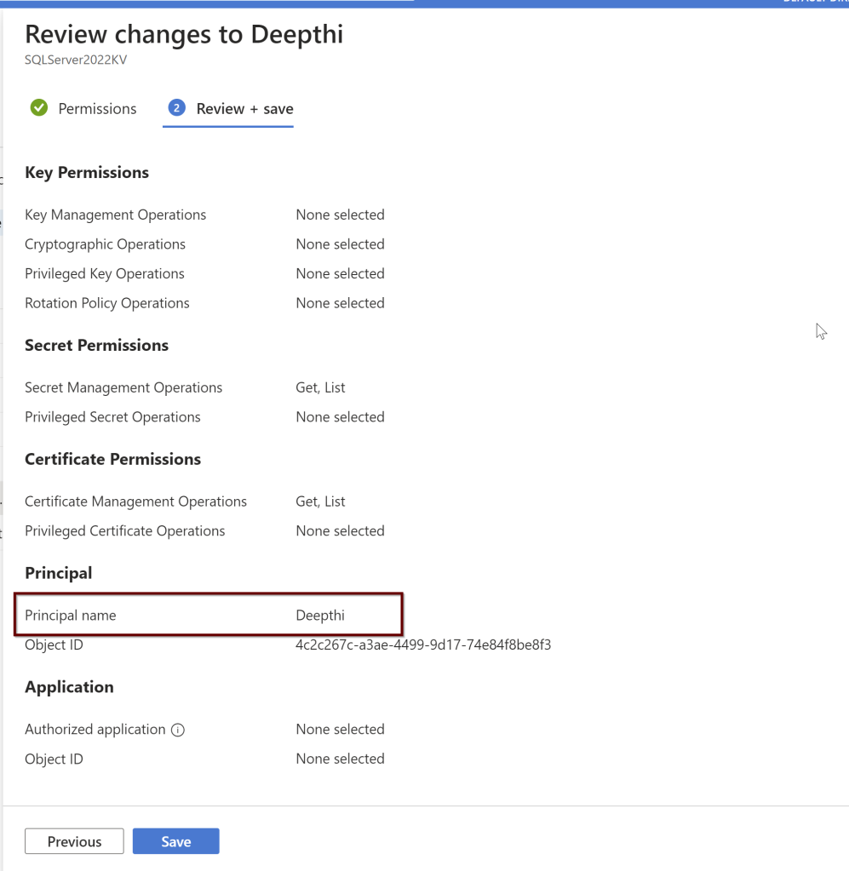
Access policies under Azure AD users 2/2

Slide 35
Extended functionality –
Certificate → Key Vault → Azure AD application automatically
But you can also create the Azure AD application manually
Point to remember: If you are creating using the ARM template, then you need to create the Key vault certificate and Azure AD application before setting up the Azure admin.

Slide 36
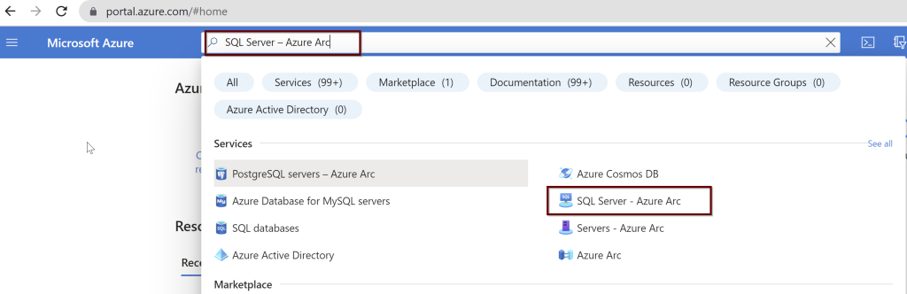
Azure AD admin setup for SQL Server

Slide 37
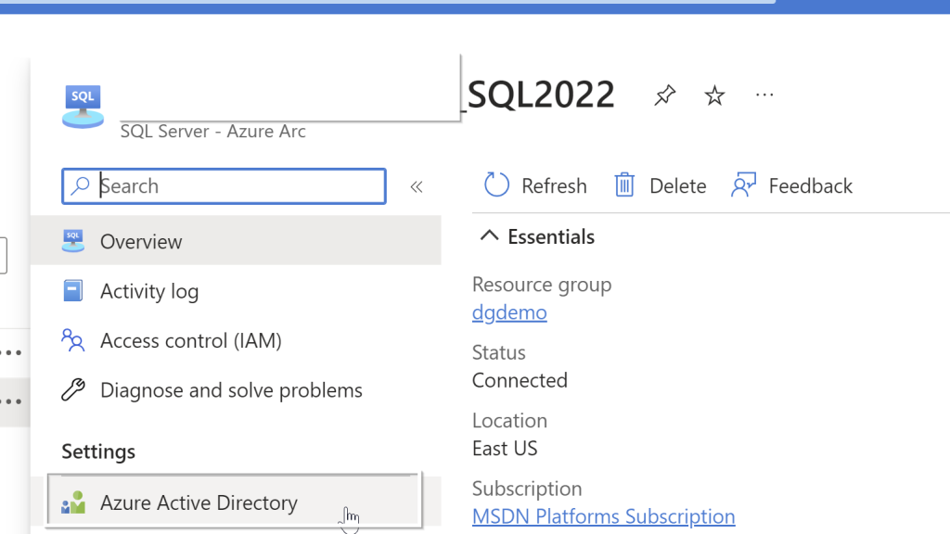

Slide 38
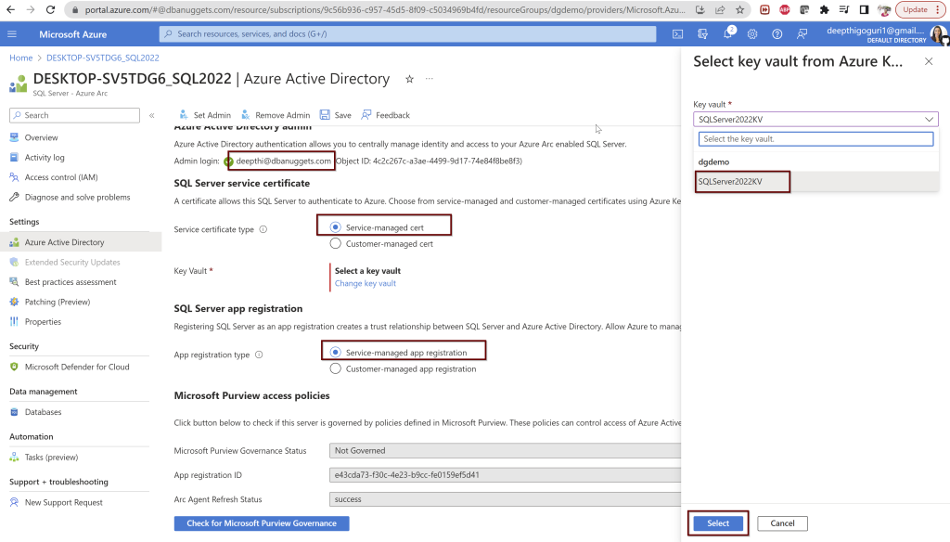

Slide 39
Behind the scenes

Slide 40


The certificate is created in the key vault you selected with the name format hostname-instancename-uniquenumber as shown below
2. The Azure AD application is created with the name in the format of hostname-instancename-uniquenumber as shown below.
The necessary permissions also will be granted to this application automatically.

Slide 41
Remember: The certificate created automatically is not managed and rotated by Microsoft. It is up to the customer to manage the certificate.

Slide 42
Install Azure AD to connect to SQL Server
Create and register an Azure AD application and Grant permissions to the Azure AD application
Create and assign a certificate
Configure Azure AD authentication for SQL Server through the Azure portal
Create logins and users
Connect with a supported authentication method

Slide 43
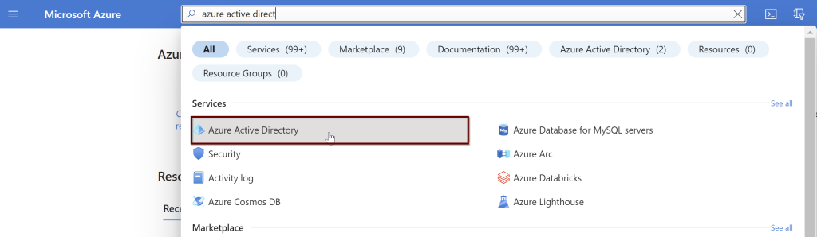
Create and register an Azure AD application

Slide 44
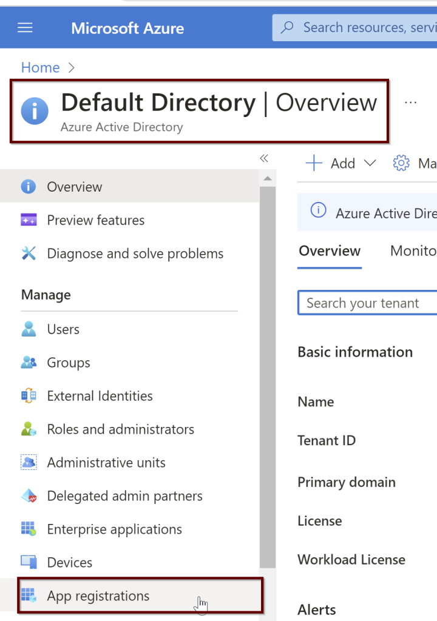
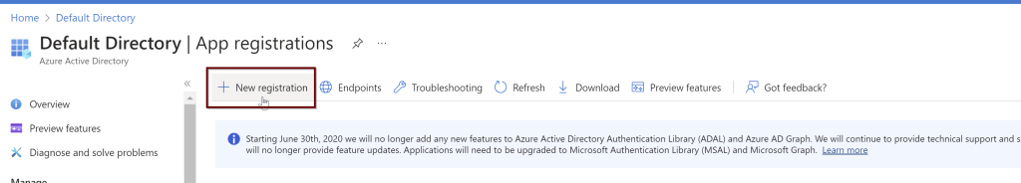

Slide 45
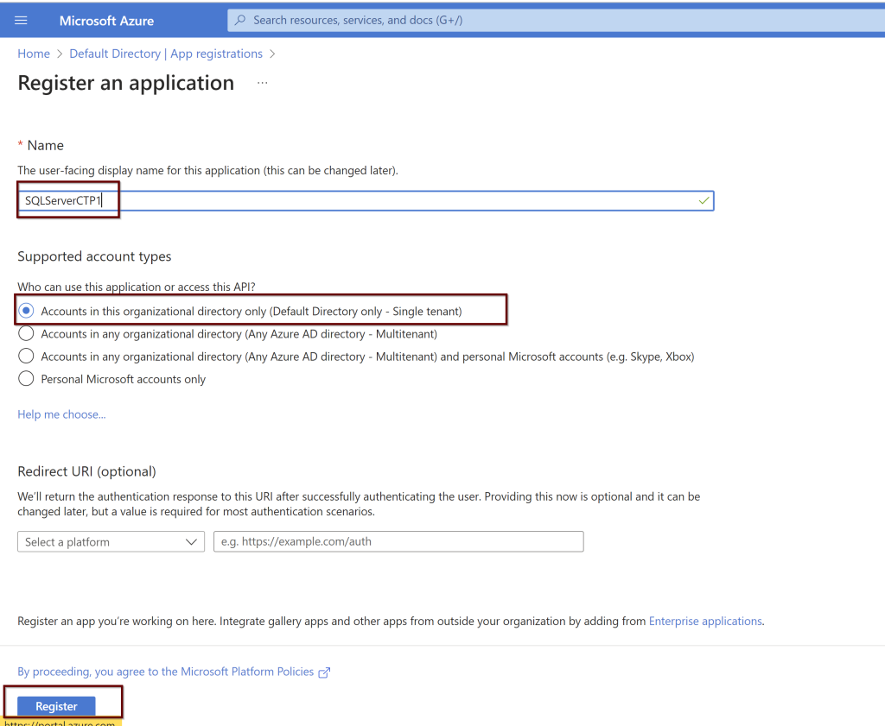

Slide 46
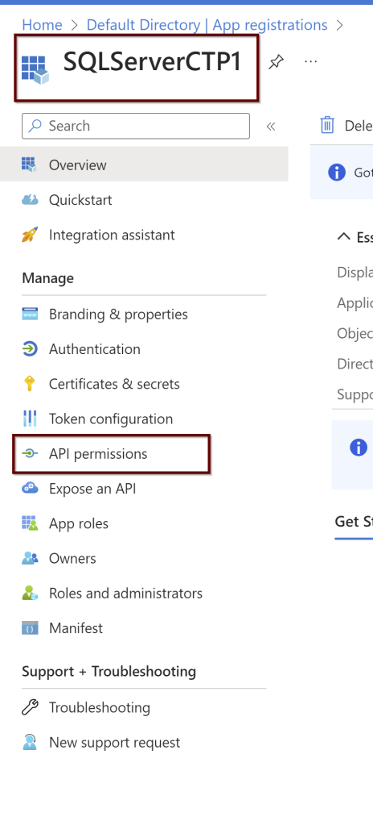
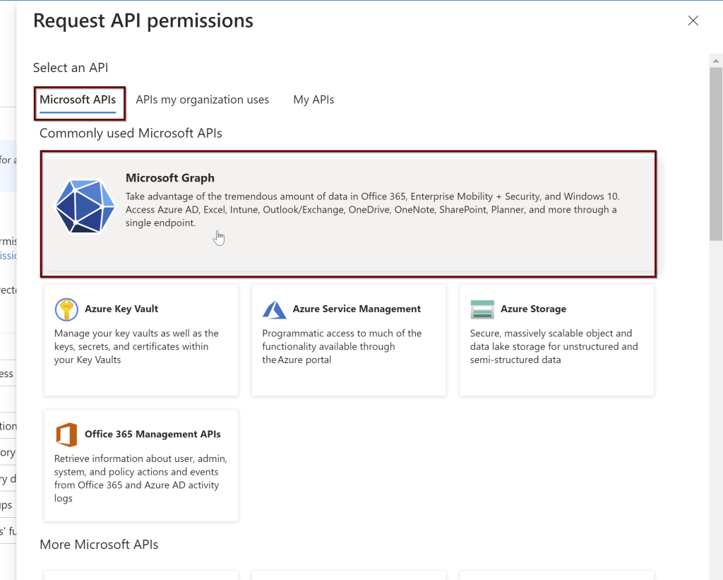

Slide 47
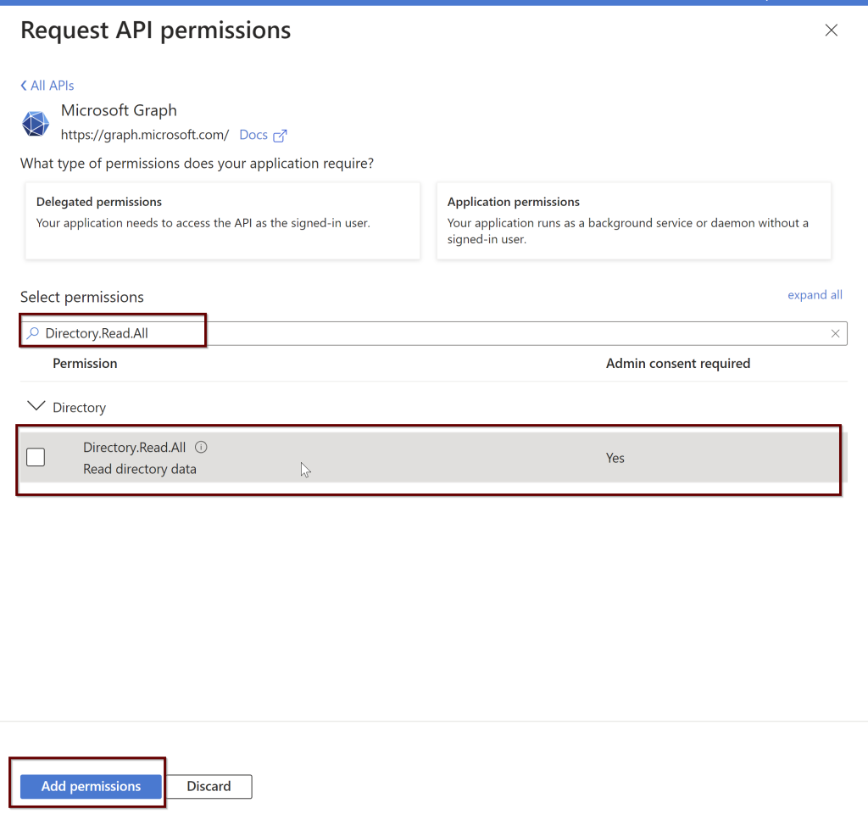
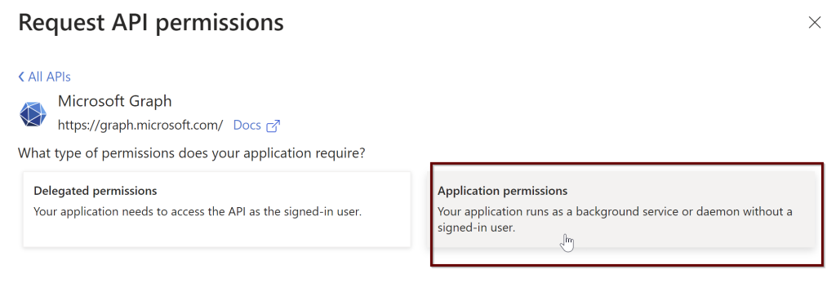

Slide 48
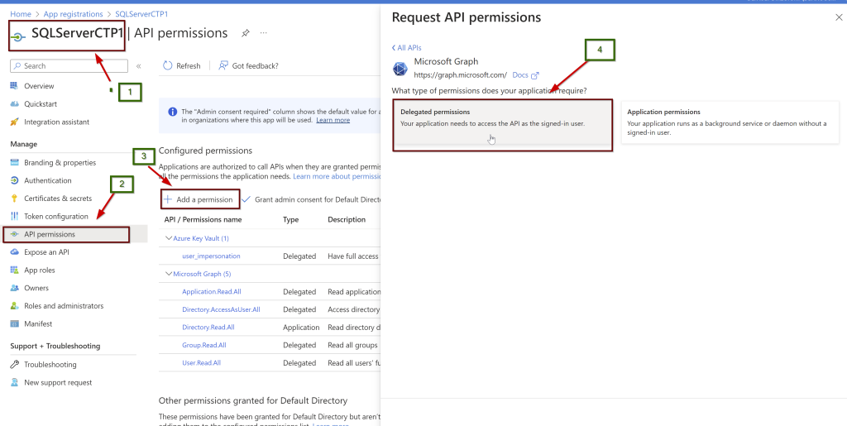

Slide 49
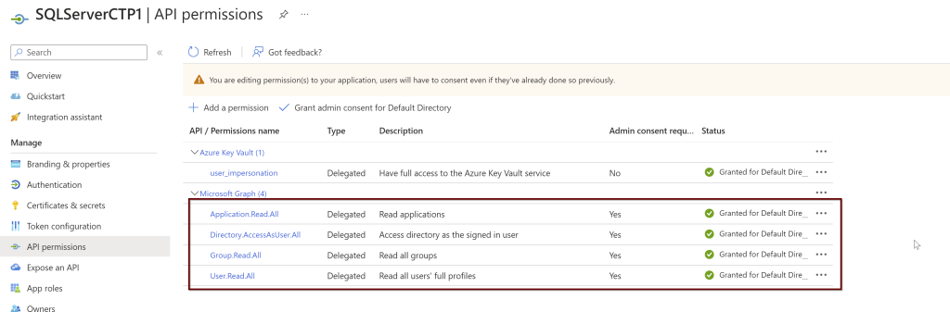
Application.Read.All
Directory.AccessAsUser.All
Group.Read.All
User.Read.All

Slide 50
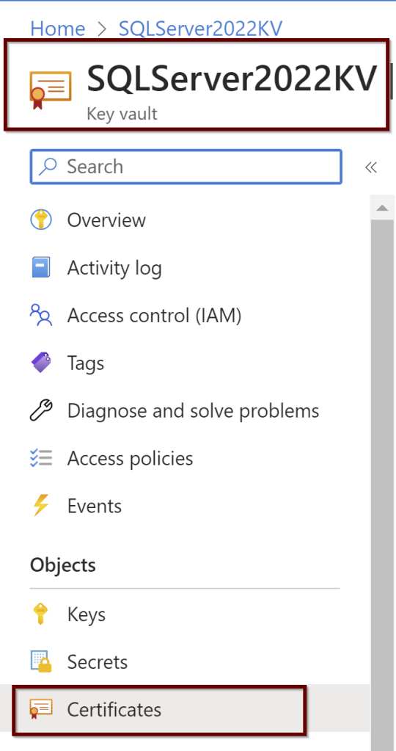
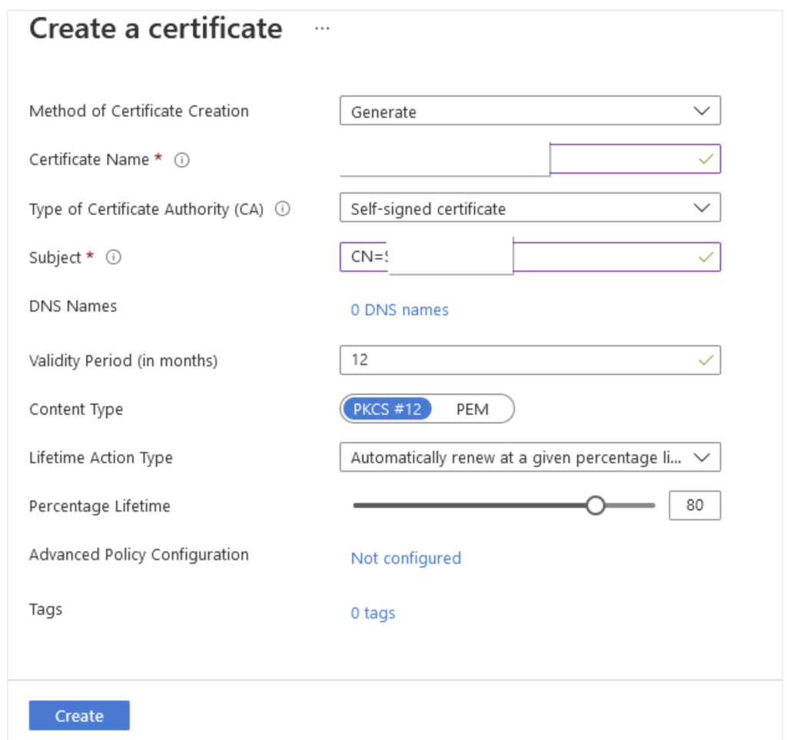
2. Create and assign the Certificate

Slide 51
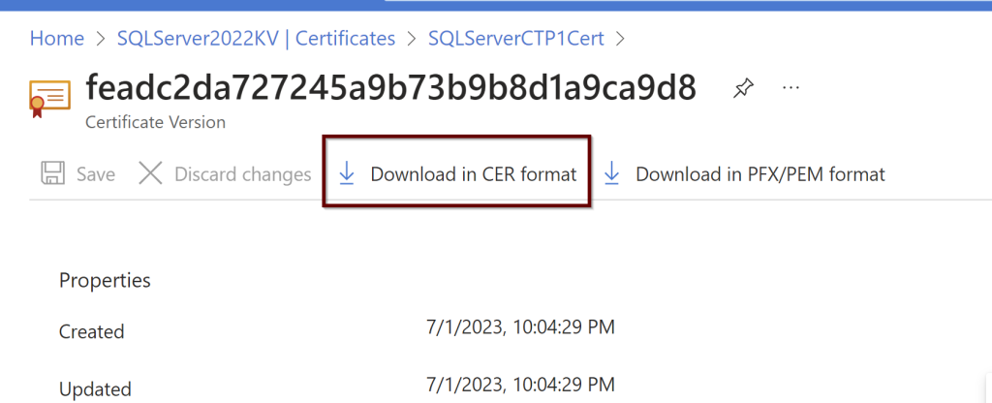
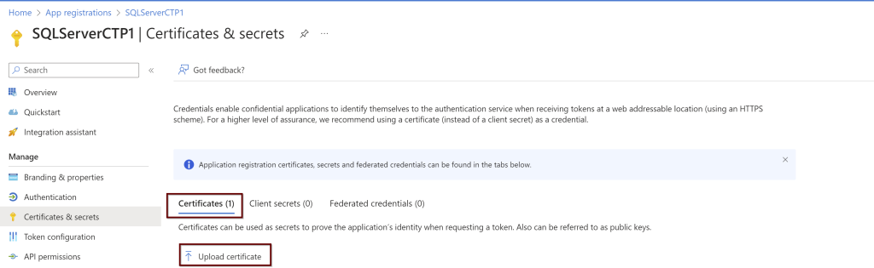

Slide 52
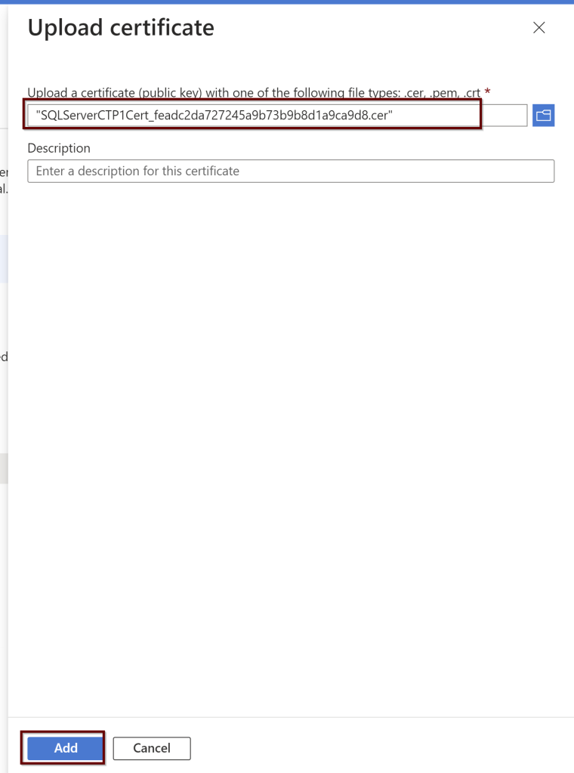

Slide 53
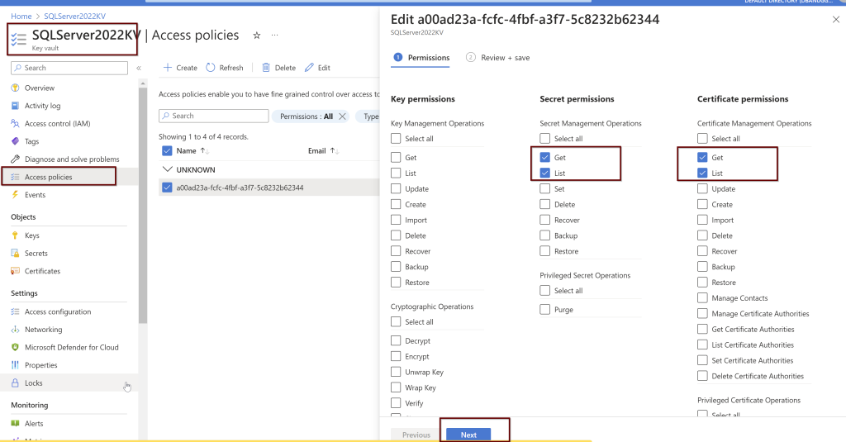

Slide 54
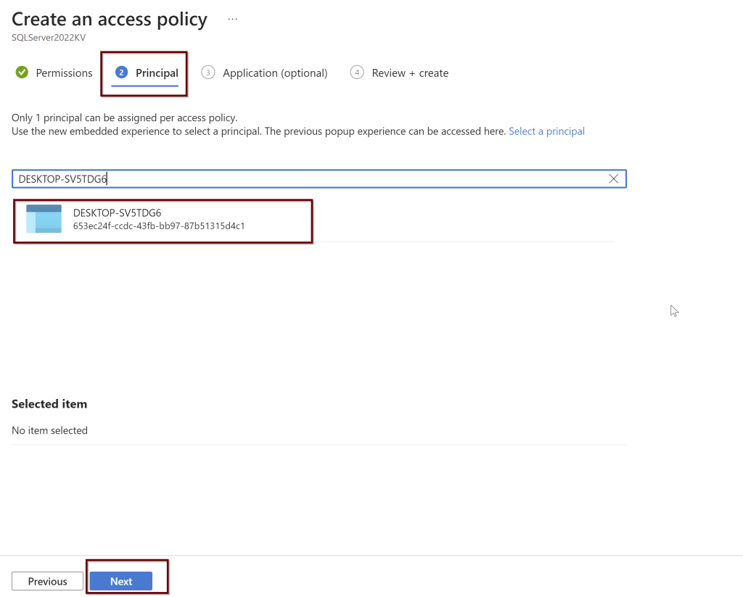

Slide 55
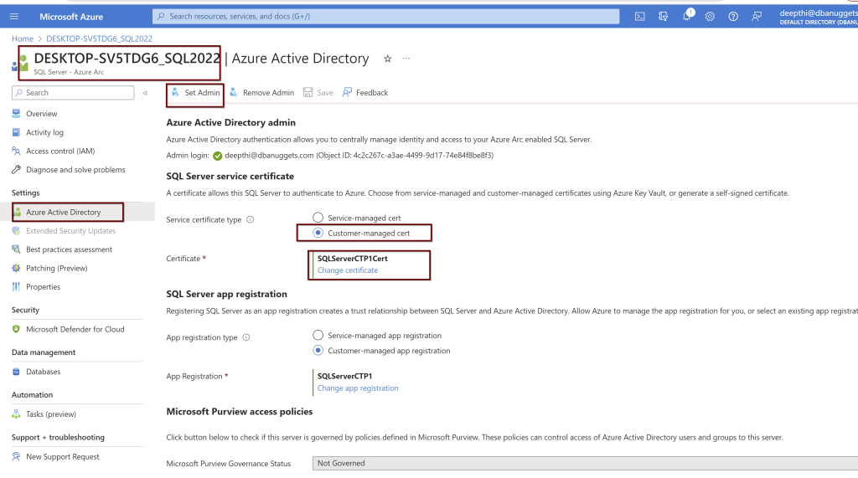
3. Configure Azure AD authentication for SQL Server by creating the Custom-managed Cert

Slide 56
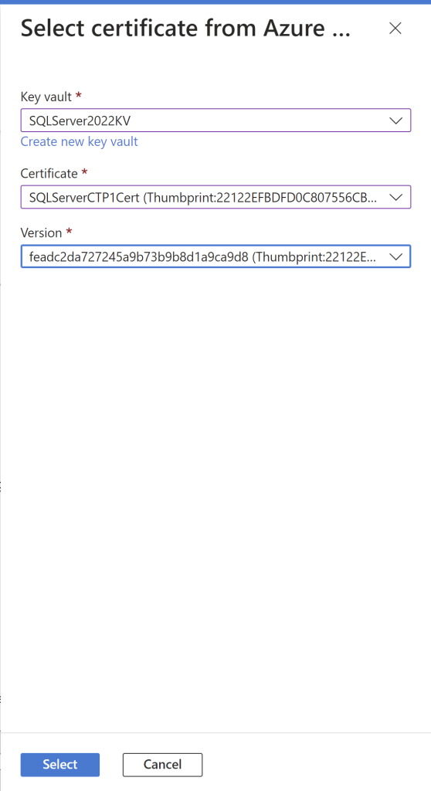

Slide 57
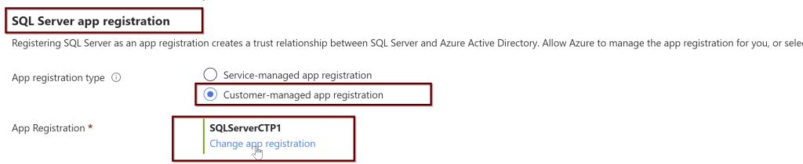
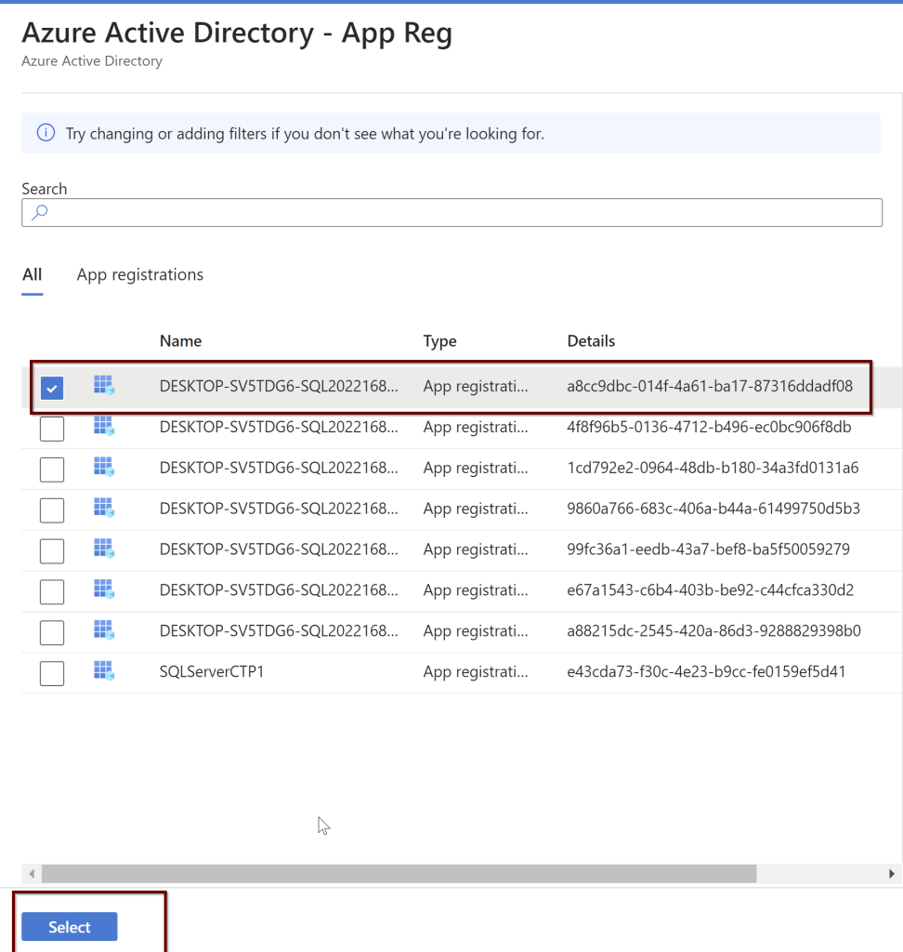

Slide 58
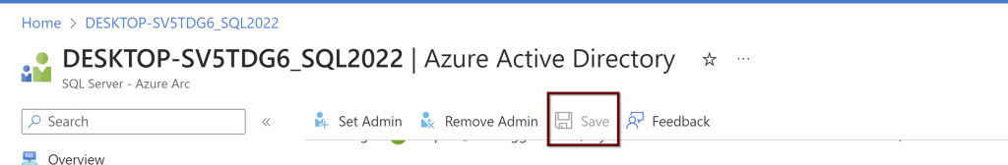

Slide 59
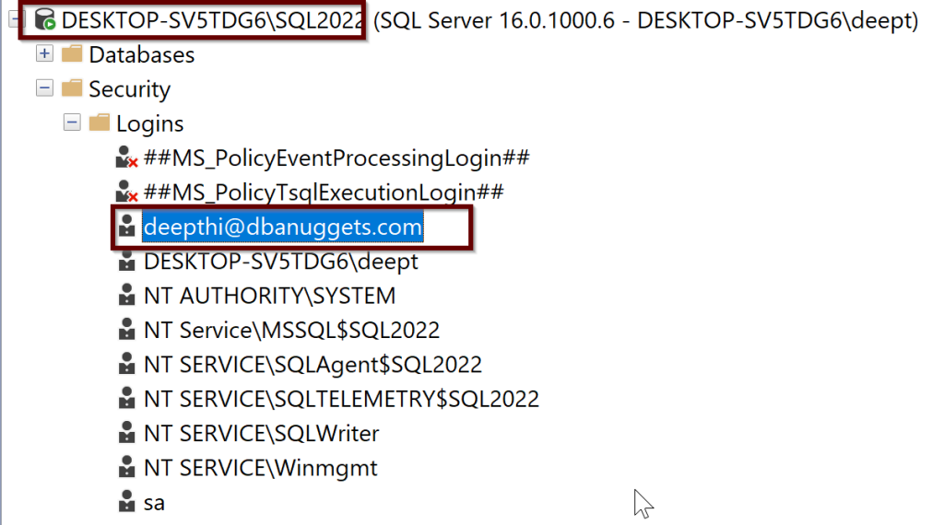
ALTER SERVER ROLE sysadmin ADD MEMBER [deepthi@dbanuggets.com]
GO

Slide 60
4. Create logins
-- login creation for Azure AD user
CREATE LOGIN [user@contoso.com] FROM EXTERNAL PROVIDER;
GO
-- login creation for Azure AD group
CREATE LOGIN [my_group_name] FROM EXTERNAL PROVIDER;
GO
-- login creation for Azure AD application
CREATE LOGIN [my_app_name] FROM EXTERNAL PROVIDER;
GO

Slide 61
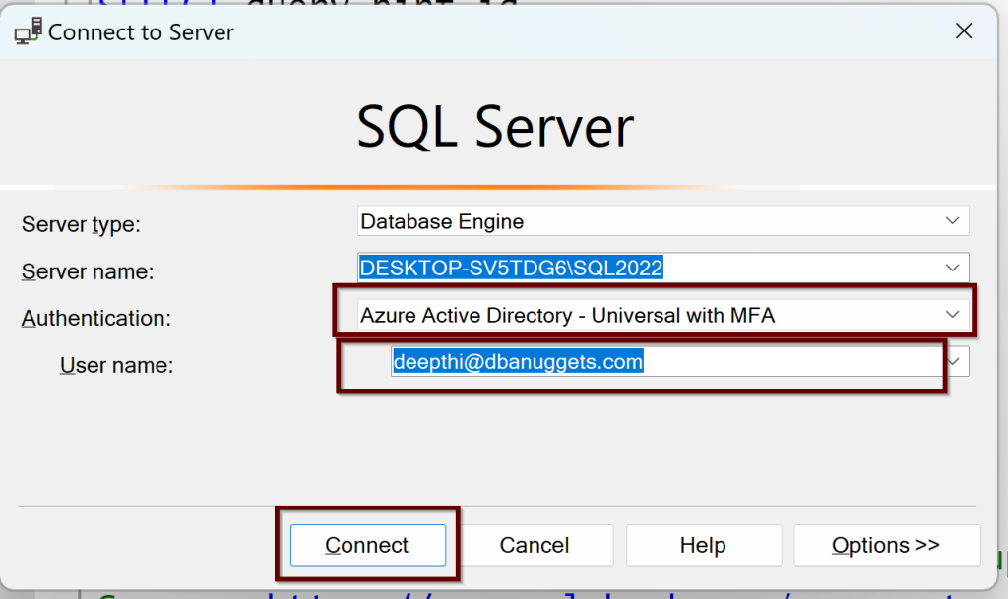
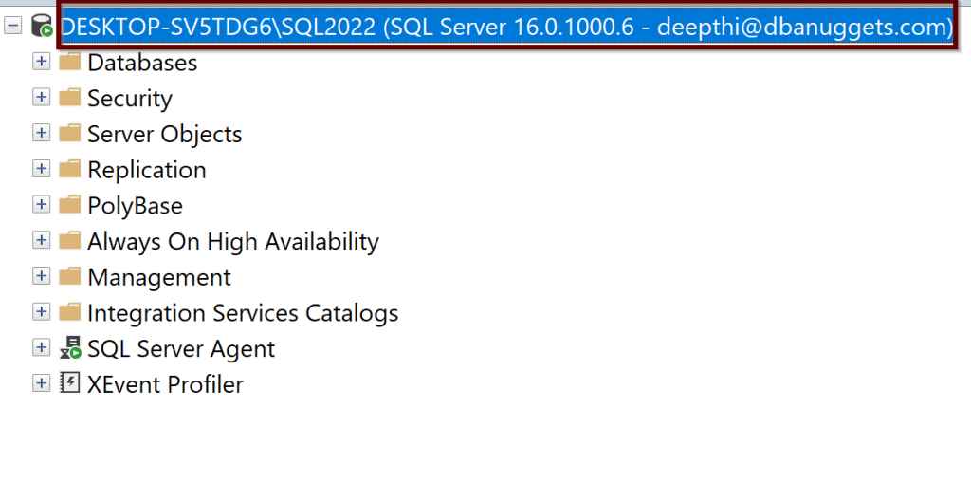
5. Connect with a supported authentication method

Slide 62
What we have learnt so far
What is Azure Arc
How to Connect your SQL Server to Azure Arc
Azure Active Directory Authentication for SQL Server

Slide 63
References
Azure Active Directory authentication for SQL Server
Set up Azure Active Directory authentication for SQL Server
Using automation to set up the Azure Active Directory admin for SQL Server

Slide 64
Thank you!

